Slide 1
Sine rule & Cosine rule

Slide 2
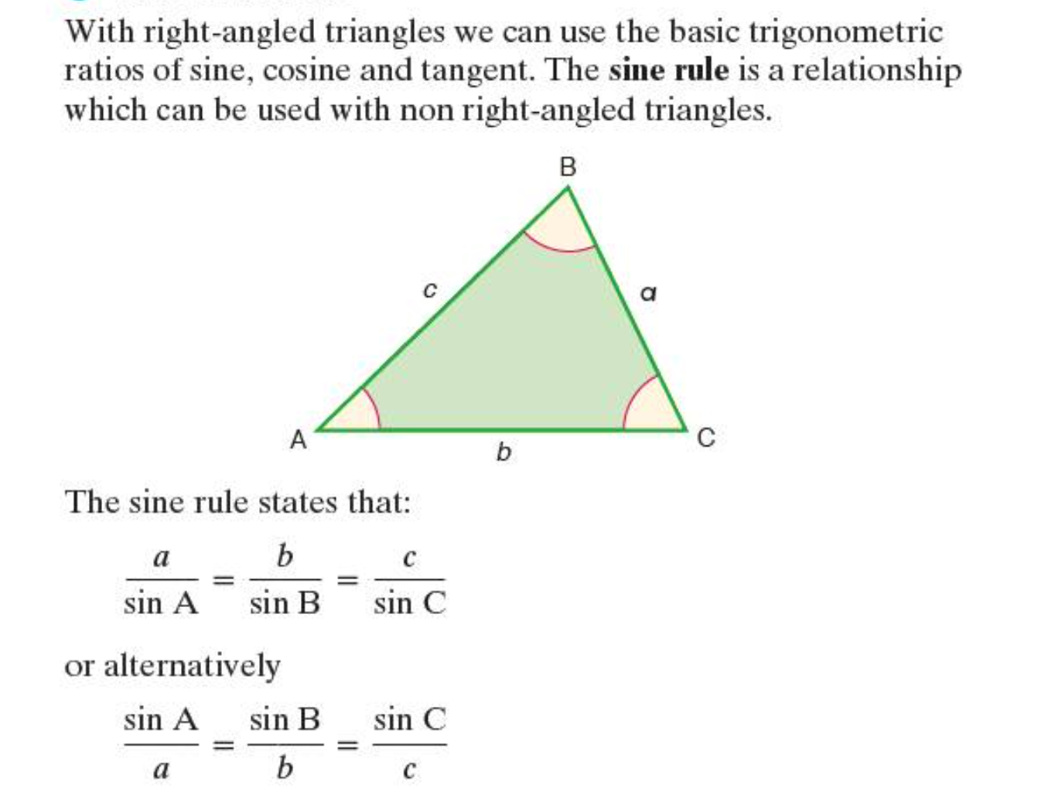
The Sine Rule

Slide 3
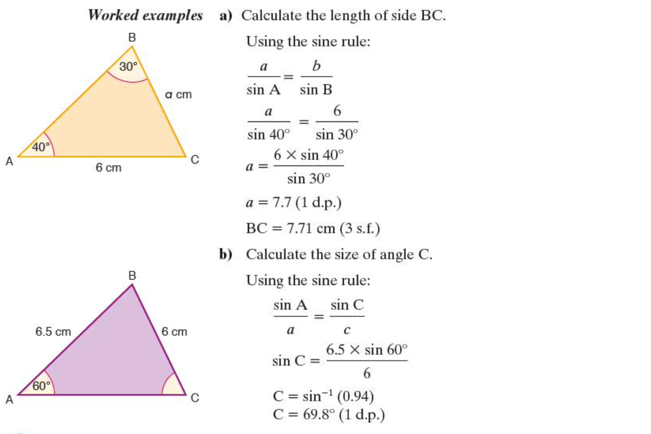

Slide 4
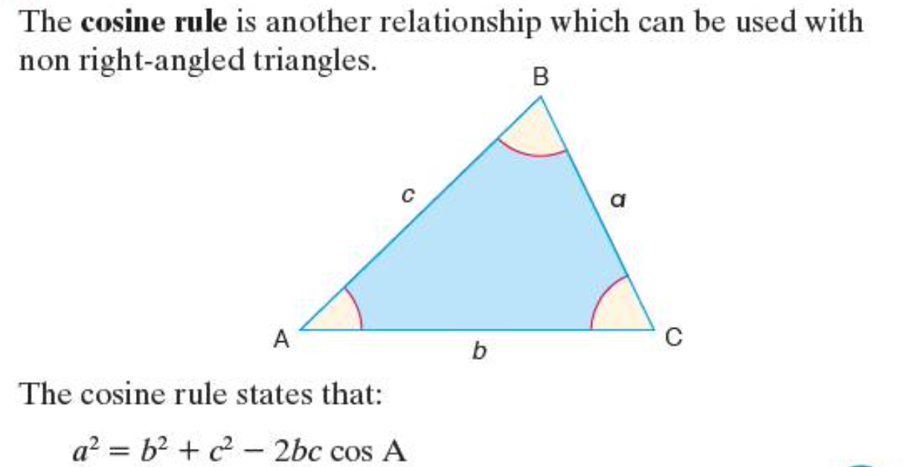
The Cosine Rule

Slide 5
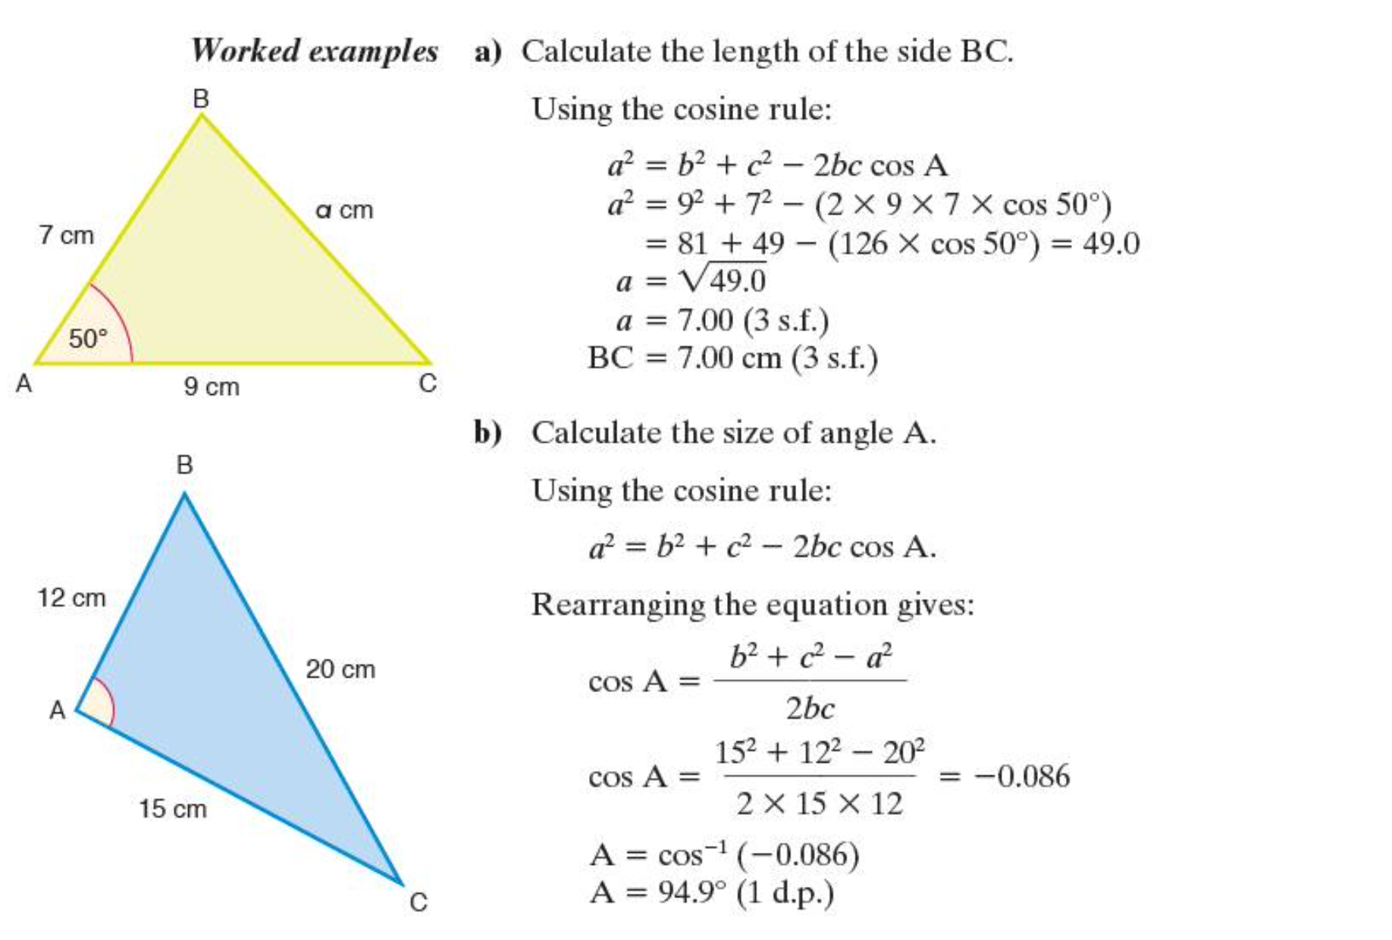

Slide 6
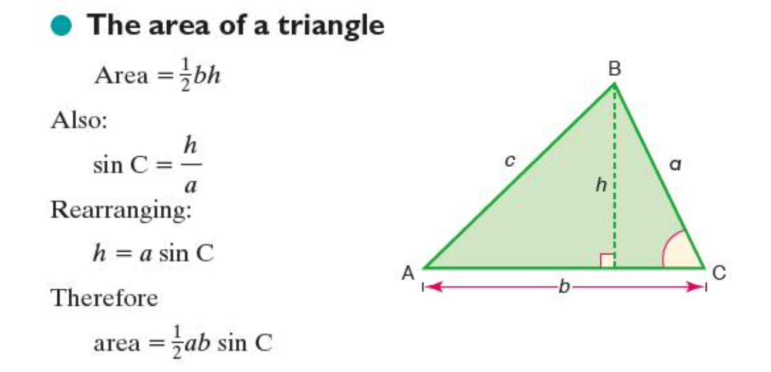
Area of triangle

Slide 7
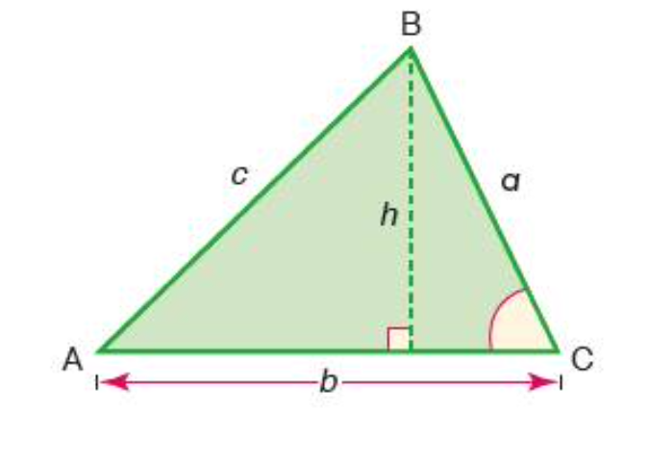


Sin a = $\frac{h}{c}$
h = c sin a
Area = $\frac{1}{2}$ hb
Area = $\frac{1}{2}$ c b sin a

Slide 8

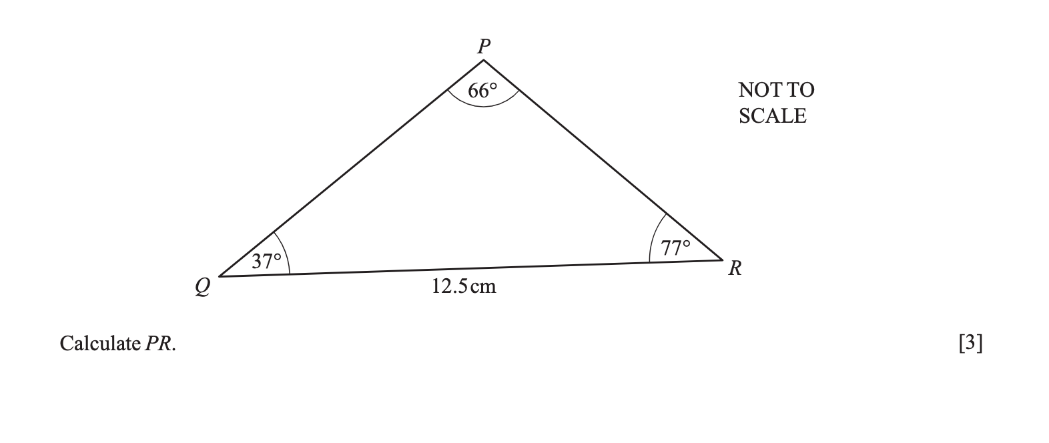

Slide 9
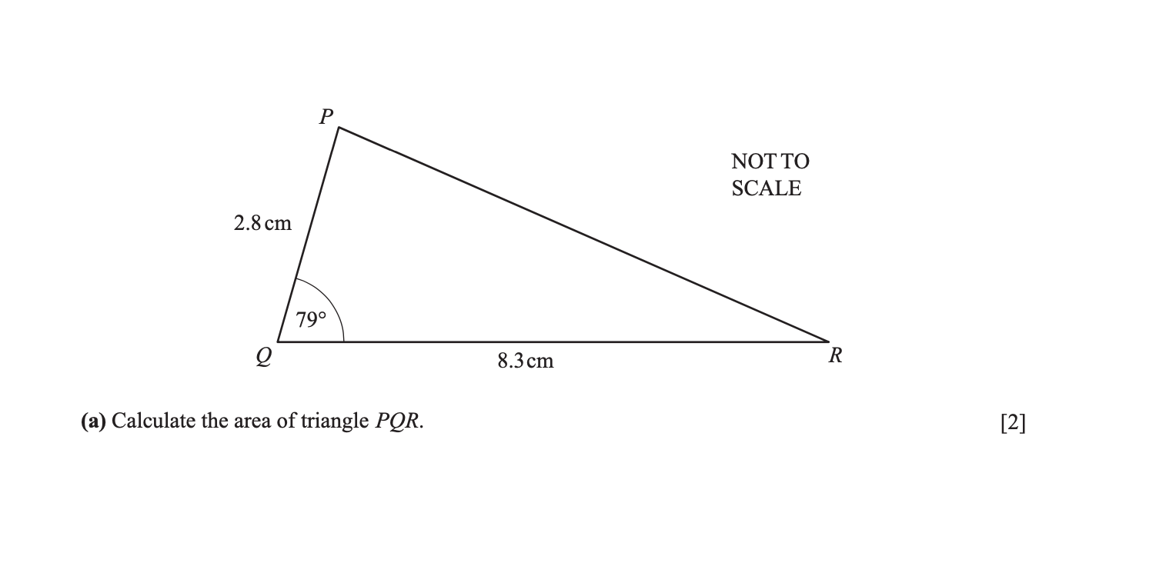

Slide 10


